Slide 1
A comparison of automatic cell identification for single-cell RNA sequencing data
Ruidong Li
October 22, 2019

Slide 2
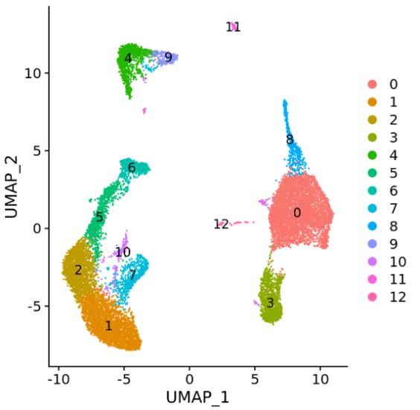
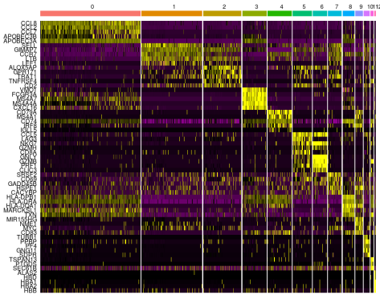
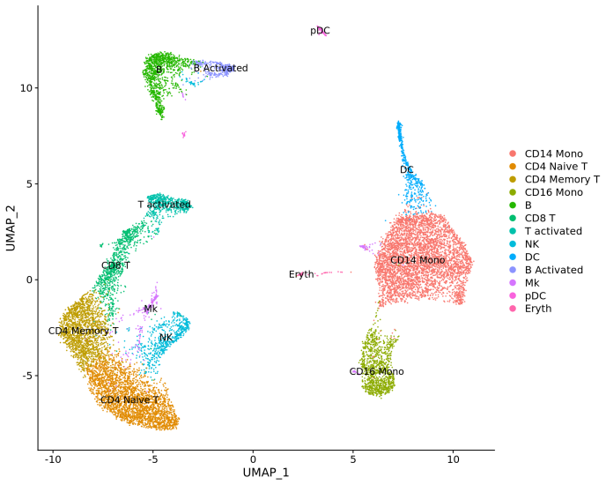
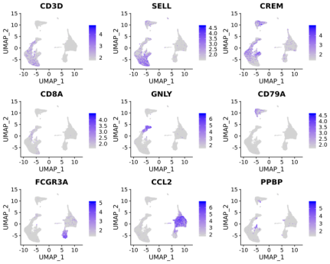
The traditional approach of constructing a cell atlas
Unsupervised clustering of the cells
Find differentially expressed features
(cluster biomarkers)
Assign cell type identity to clusters
Labor intensive, requiring extensive literature review of cluster-specific genes
Any revision to the analysis (for example, additional data, parameter adjustment) requires manual reevaluation of all previous annotations
Not reproducible across different experiments within and across research groups
Notes:
Despite this being the most common approach
Cumbersome and time-consuming as it involves manual inspection of cluster-specific marker genes
manual annotations, which are often not based on standardized ontologies of cell labels, are not reproducible across different experiments within and across research groups
The computational steps of constructing a cell atlas typically include unsupervised clustering of cells based on their gene expression profiles, followed by annotation of known cell types among the resulting clusters
First, cell type annotation is labor
intensive, requiring extensive literature review of cluster-specific
genes4. Second, any revision to the analysis (for example, additional
data, parameter adjustment) necessitates manual reevaluation of all
previous annotations. Third, annotations are not easily transferred
between datasets generated by independent groups on related tissues,
resulting in wasteful repetition of effort. Finally, annotation
labels are typically ad hoc; although ontologies of cell types exist5,6,
we lack tools for systematically applying these ontologies to scRNAseq
data. Collectively, these challenges hinder progress toward a consensus
framework for cell types and the features that define them

Slide 3

Comprehensive evaluation of automatic cell annotation
22 automatic cell identification methods, including general-purpose classifiers
27 publicly available single-cell RNA sequencing datasets of different sizes, technologies, species, and levels of complexity
2 experimental setups: within dataset (intra-dataset) and across datasets (inter-dataset)
Evaluation metrics: accuracy (F1 score) and percentage of unclassified cells
Notes:
Share a common goal: accurate annotation of cells
They differ in terms of their underlying algorithms and the incorporation of prior knowledge (e.g., cell type marker gene tables)
benchmarked 22 classification methods to automatically assign cell identities including single-cellspecific and general-purpose classifiers
Evaluated using 27 publicly available single-cell RNA sequencing datasets of different sizes, technologies, species, and complexity
We evaluated the classification performance through two experimental setups: (1) intra-dataset in which we applied 5-fold cross-validation within each dataset and (2) interdataset involving across datasets comparisons
The performance of the methods was evaluated based on their accuracy, percentage of unclassified cells, and computation time
The interdataset comparison is more realistic and more practical, where a reference dataset (e.g., atlas) is used to train a classifier which can then be applied to identify cells in new unannotated datasets
However, in order to perform well across datasets, the classifier should also perform well using the intra-dataset setup on the reference dataset
The intra-dataset experiments, albeit artificial, provide an ideal scenario to evaluate different aspects of the classification process (e.g., feature selection, scalability, and different annotation
levels), regardless of the technical and biological variations across datasets

Slide 4
Main conclusions
Most classifiers perform well across all the datasets
Classification performance depends on dataset complexity. All classifiers have an almost perfect performance for easy classification task, while it remains challenging for complex datasets with overlapping classes or deep annotations
The general-purpose support vector machine (SVM) classifier has overall the best performance across the different experiments
The performance of some classifiers may be underestimated, tuning parameters of such classifiers may improve their performance, especially for the marker gene-based methods and reference-based methods

Slide 5
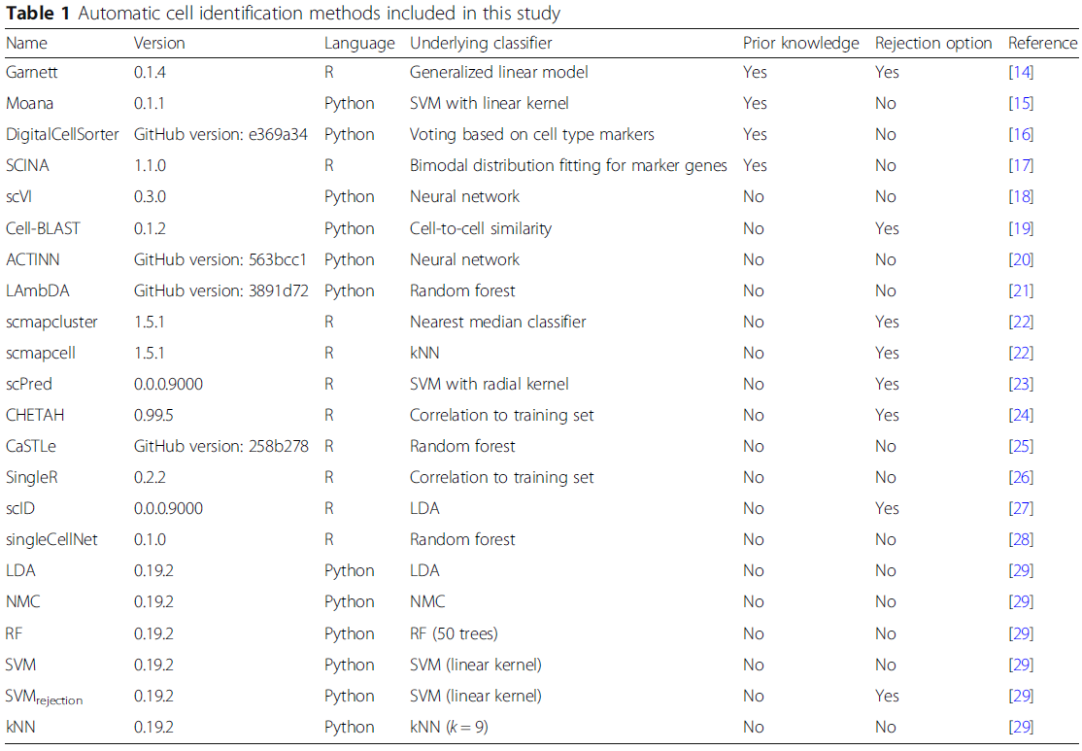
Overview of the automatic cell annotation methods
Nature Methods
bioRxiv
BMC Bioinformatics
Genes
Nature Methods
bioRxiv
Bioinformatics
Bioinformatics
Nature Methods
Nature Methods
bioRxiv
Nucleic Acids Research
PLoS One
Nature immunology
bioRxiv
Cell Systems
Notes:
supervised methods which require a training dataset labeled with the corresponding cell populations in order to train the classifier
prior-knowledge methods, for which either a marker gene file is required as an input or a pretrained classifier for specific cell populations is provided
CellAssign
scMatch
CellO

Slide 6

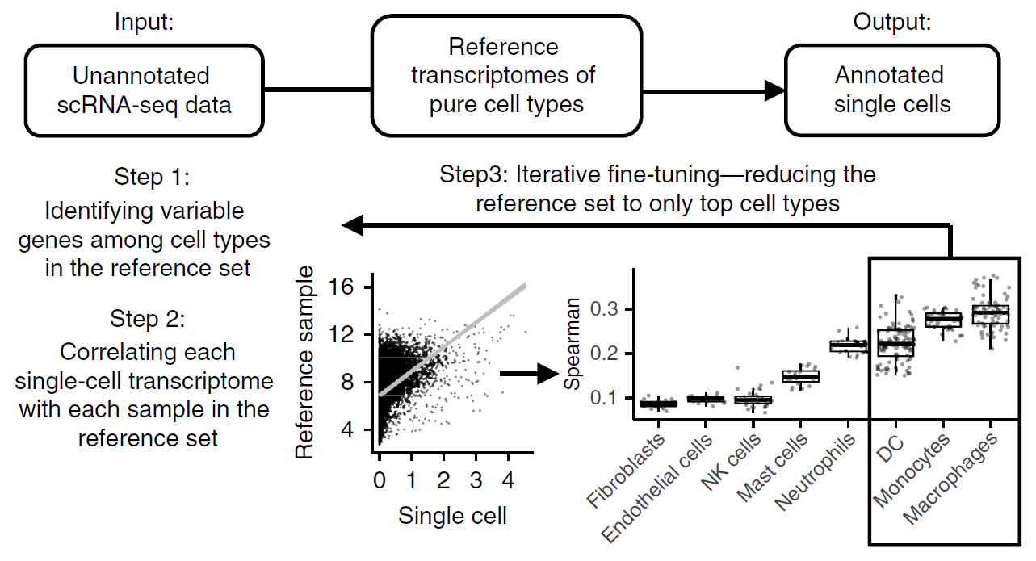
SingleR
The SingleR pipeline is based on correlating reference bulk transcriptomic data sets of pure cell types with single-cell gene expression
7 built-in reference sets of bulk RNAseq of pure cell types
Also support single-cell references
Spearman coefficient
Notes:
In the first step of the SingleR pipeline, a Spearman coefficient was calculated
for single-cell gene expression with each of the samples in the reference
data set, using only the variable genes in the reference data set.
Using only variable genes among the cell types increased the ability
to distinguish closely related cell types. This process was performed
iteratively using only the top cell types from the previous step and
the variable genes among them until only one cell type remained

Slide 7
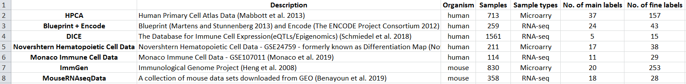

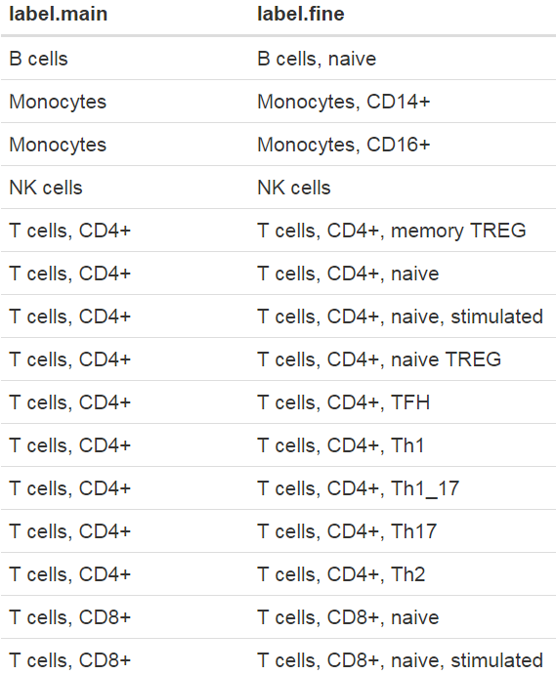
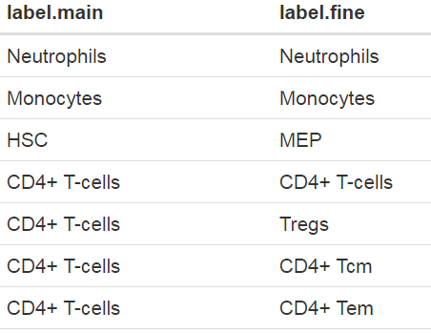
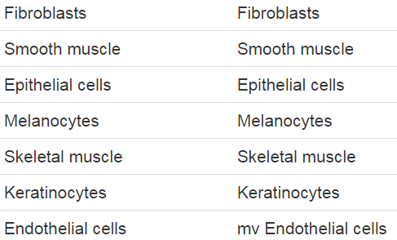
SingleR reference datasets

Slide 8
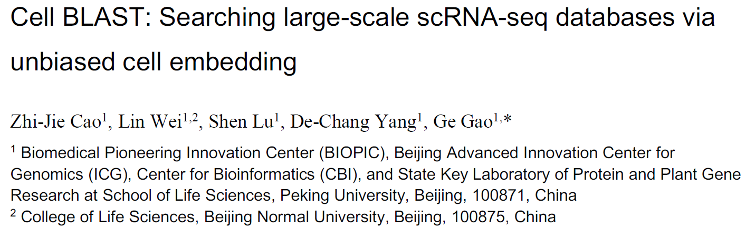

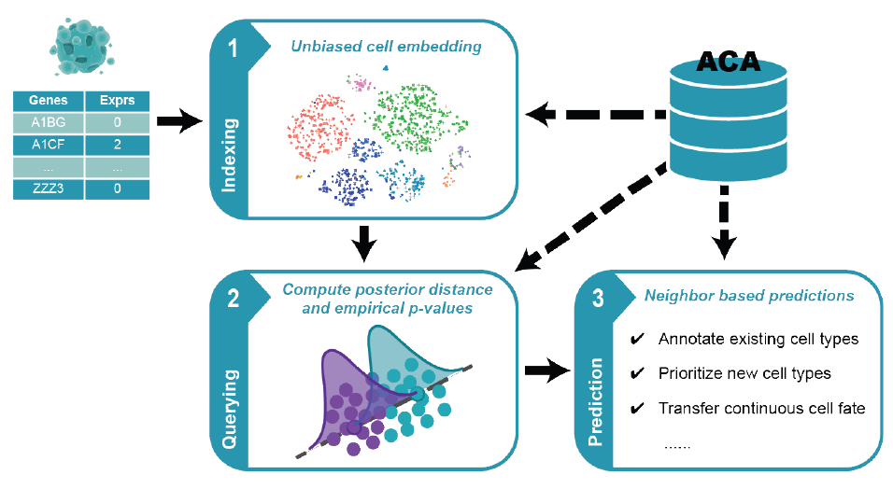
Cell BLAST
A new customized deep generative model together with a novel cell-to-cell similarity metric specifically designed for cell querying
Curated 391 single-cell RNAseq datasets with 986,305 cells in total, which covers 27 distinct organs across 8 species

Slide 9
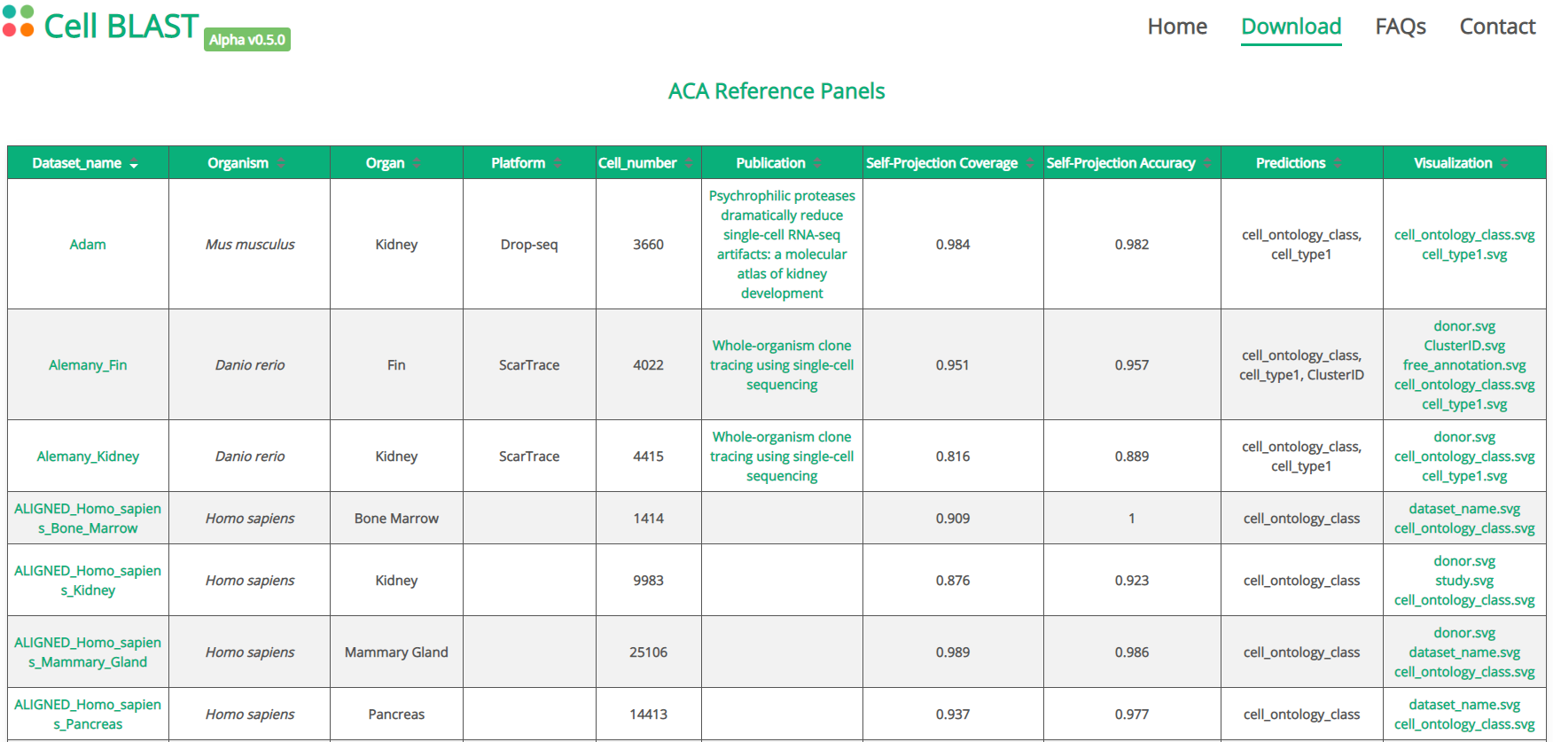
Cell BLAST reference datasets
Curated 391 single-cell RNAseq datasets with 986,305 cells in total, which covers 27 distinct organs across 8 species
All records in ACA are collected and annotated using a standard procedure

Slide 10
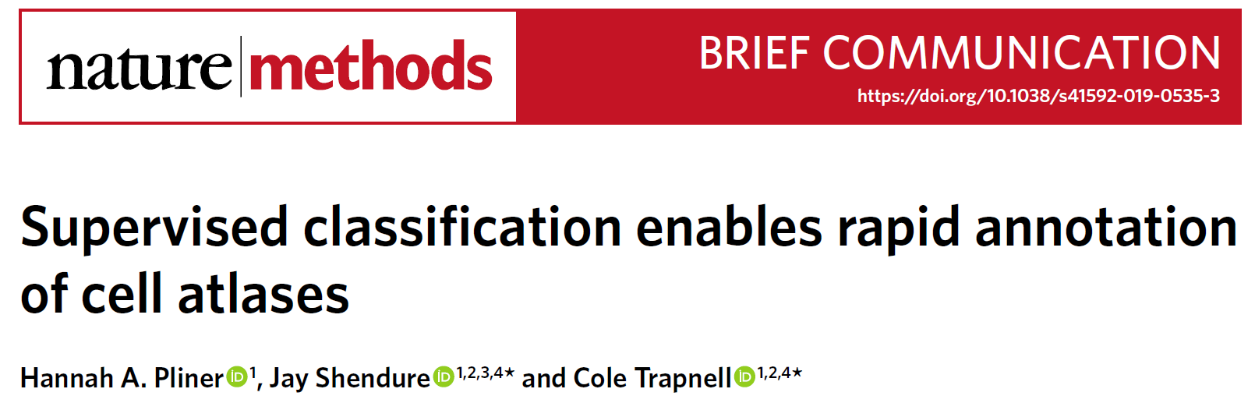
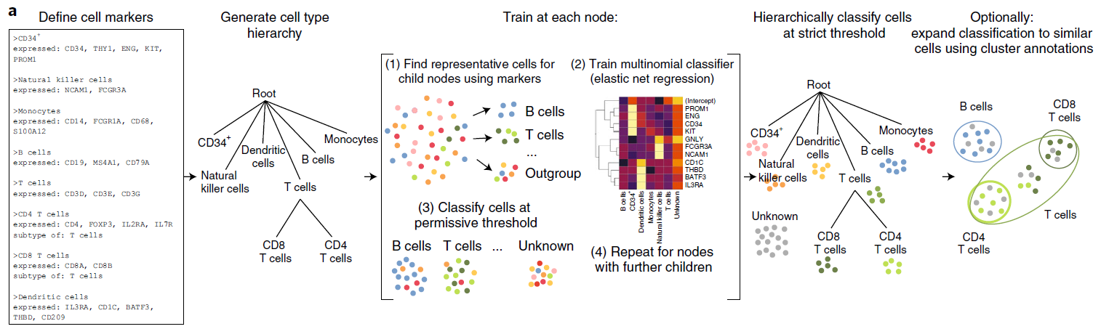
Garnett
Automates and standardizes the process of classifying cells based on marker genes
Doesn’t require pre-classified training datasets
Garnett uses a marker file to allow users to specify cell type definitions. These definitions are then used to choose representative cells from each cell type to use when training the classifier
Notes:
Garnett provides a method for applying a classifier trained on one dataset to rapidly annotate additional datasets
Moreover, by expanding cell type assignments to nearby cells using
Louvain clustering9 (cluster-extended type), correct assignments
increased to 94% (2% incorrect, 4% unclassified), with 91% of
T cells also receiving a correct subtype classification (8% not subclassified,
<1% unclassified, <1% incorrect).

Slide 11
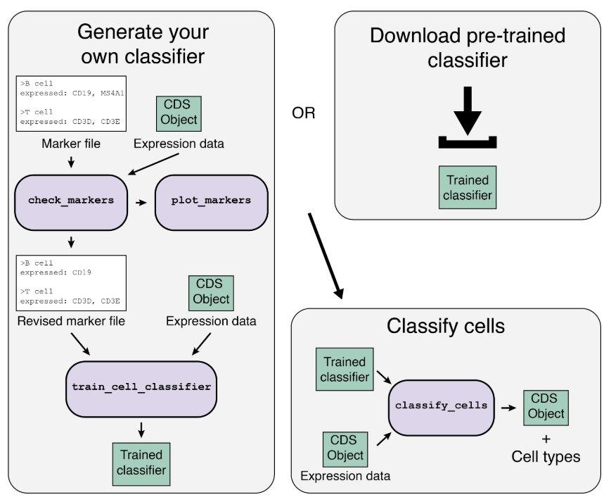
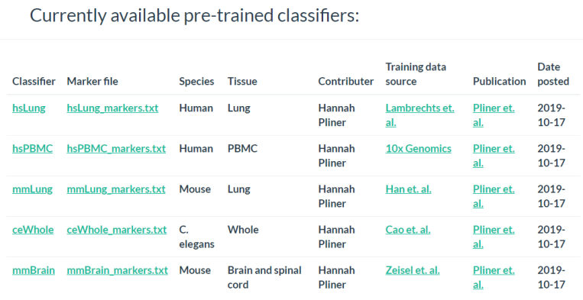
Garnett classifiers

Slide 12
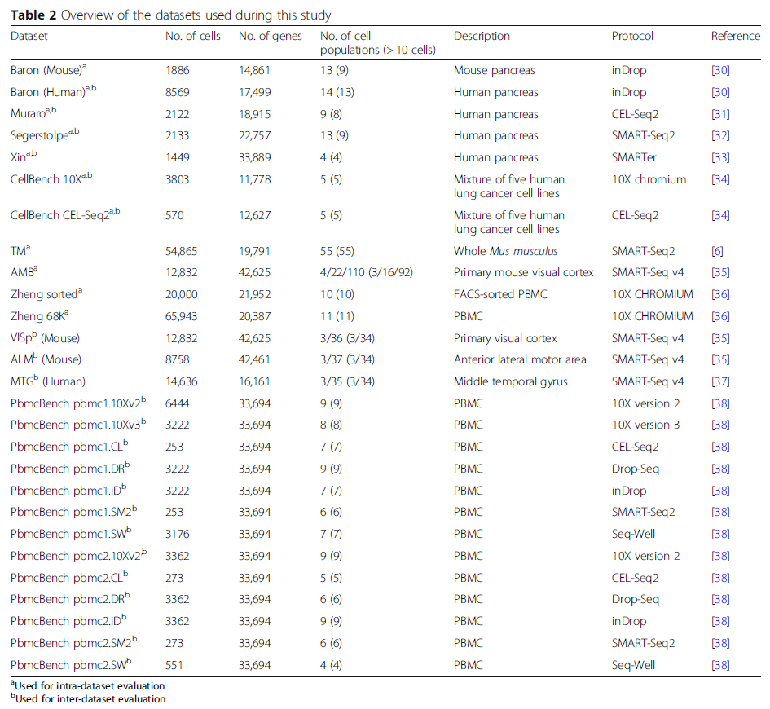
Overview of the single-cell RNAseq datasets
Number of cells:
Typical sized datasets: 1500~8500
Large datasets: > 50,000
Protocols:
10X Chromium
Drop-Seq
InDrop
CEL-Seq2
SMART-Seq2
Annotation levels:
Allen Mouse Brain (AMB) dataset:
3, 16, or 92 cell populations
Sorted populations:
CellBench dataset: Lung cancer cell lines
Zheng sorted dataset: PBMC
PBMC datasets:
Zheng sorted dataset
Zheng 68K dataset
PbmcBench dataset
Notes:
The datasets used in this study vary in the number of cells, genes, and cell populations (annotation level), in order to represent different levels of challenges in the classification task and to evaluate how each classifier performs in each case
5 pancreas datasets: relatively typical sized scRNA-seq datasets (1500–8500 cells), both mouse and human pancreatic cells, and vary in the sequencing protocol used
The Tabula Muris (TM) and Zheng 68K datasets: represent relatively large scRNA-seq datasets (> 50,000 cells) and are used to assess how well the classifiers scale with large datasets
Allen Mouse Brain (AMB) dataset: evaluate how the classification performance changes when dealing with different levels of cell population annotation as the AMB dataset contains three levels of annotations for each cell (3, 16, or 92 cell populations), denoted as AMB3, AMB16, and AMB92, respectively
For all previous datasets, cell populations were obtained through clustering
To assess how the classifiers perform when dealing with sorted populations, we included the CellBench dataset and the Zheng sorted dataset, representing sorted populations for lung cancer cell lines and peripheral blood mononuclear cells (PBMC), respectively
Including the Zheng sorted and Zheng 68K datasets allows the benchmarking of 4 prior-knowledge classifiers, since the marker gene files or pretrained classifiers are available for the 4 classifiers for PBMCs

Slide 13
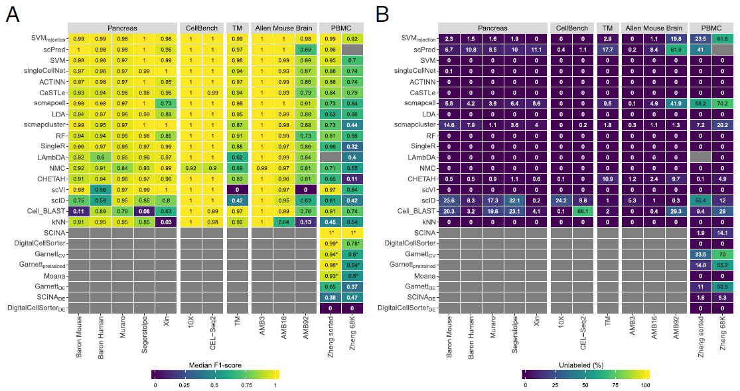
Performance evaluation within a dataset
F1 Score
Percentage of unlabeled cells
All classifiers perform well in the intra-dataset experiments with some exceptions (eg. Cell BLAST performs poorly for 2 pancreatic datasets; scVI doesn’t work on the deeply annotated datasets: TM [55 cell populations] and AMB92 [92 cell populations]); SVM is always in the top five list for all the datasets
For easy classification task, all the classifiers perform almost perfectly (eg., CellBench datasets: five sorted lung cancer cell lines that are quite separable; AMB3: three major brain cell types)
For complex datasets with overlapping classes or deep annotations, the performance of all the classifiers drops (eg., AMB16: slightly more challenging, the performance of some classifiers drops, especially KNN; AMB92: the performance of all the classifiers drops further
Notes:
It considers both the precision p and the recall r of the test to compute the score
The traditional F-measure or balanced F-score (F₁ score) is the harmonic mean of precision and recall
F₁ score = 2 · Precision · Recall/Precision + Recall
all classifiers perform well in the intra-dataset experiments
Cell-BLAST performs poorly for the Baron Mouse and Segerstople pancreatic datasets
scVI has low performance on the deeply annotated datasets TM (55 cell populations) and AMB92 (92 cell populations)
kNN produces low performance for the Xin and AMB92 datasets.
SVM is the only classifier to be in the top five list for all five pancreatic datasets (xxx); NMC, for example, appears only in the top five list for the Xin dataset
The Xin dataset contains only four pancreatic cell types (alpha, beta, delta, and gamma) making the classification task relatively easy for all classifiers, including NMC
Considering the median F1-score alone to judge the classification performance can be misleading since some classifiers incorporate a rejection option (e.g., SVMrejection, scmapcell, scPred), by which a cell is assigned as “unlabeled” if the classifier is not confident enough.
for the Baron Human dataset, the median F1-score for SVMrejection, scmapcell, scPred, and SVM is 0.991, 0.984, 0.981, and 0.980, respectively (Fig. 1a). However, SVMrejection, scmapcell, and scPred assigned 1.5%, 4.2%, and 10.8% of the cells, respectively, as unlabeled while SVM (without rejection) classified 100% of the cells with a median F1-score of 0.98
an overall better performance for SVM and SVMrejection, with higher performance and less unlabeled cells
The CellBench 10X and CEL-Seq2 datasets represent an easy classification task, where the five sorted lung cancer cell lines are quite separable [34]. All classifiers have an almost perfect performance on both CellBench datasets (median F1-score ≈ 1).
For the TM dataset, the top five performing classifiers are SVMrejection, SVM, scmapcell, Cell-BLAST, and scPred with a median F1-score > 0.96, showing that these classifiers can perform well and scale to large scRNA-seq datasets with a deep level of annotation. Furthermore, scmapcell and scPred assigned 9.5% and 17.7% of the cells, respectively, as unlabeled, which shows a superior performance for SVMrejection and SVM, with a higher median F1-score and 2.9% and 0% unlabeled cells, respectively
We used the AMB dataset with its three different levels of annotations, to evaluate the classifiers’ performance behavior with an increasing number of smaller cell populations within the same dataset
For AMB3, the classification task is relatively easy, differentiating between three major brain cell types (inhibitory neurons, esxcitatory neurons, and non-neuronal). All classifiers perform almost perfectly with a median F1-score > 0.99
For AMB16, the classification task becomes slightly more challenging and the performance of some classifiers drops
For the deeply annotated AMB92 dataset, the performance of all classifiers drops further, specially for kNN and scVI
There results show an overall superior performance for generalpurpose classifiers (SVMrejection, SVM, and LDA) compared to other scRNA-seq-specific classifiers across different levels of cell population annotation
PBMC: SCINA with a median F1-score of 0.998, this performance is based only on 3, out of 11, cell populations (Monocytes, B cells, and NK cells) for which marker genes are provided
Garnett, Moana, and DigitalCellSorter could be tested on 7, 7, and 5 cell populations, respectively (Additional file 1: Table S1)
Generally, all classifiers show relatively lower performance on the Zheng 68K dataset compared to other datasets, as the Zheng 68K dataset contains 11 immune cell populations which are harder to differentiate, particularly the T cell compartment (6 out of 11 cell populations)
Also, the confusion matrices for CaSTLe, ACTINN, singleCell-Net, and SVM clearly indicate the high similarity between cell populations, such as (1) monocytes with dendritic cells, (2) the 2 CD8+ T populations, and (3) the 4 CD4+ T populations (Additional file 1: Figure S2).
Zheng sorted: The prior-knowledge methods show high performance (median F1-score > 0.93), which is still comparable to other classifiers such as SVMrejection, scVI, scPred, and SVM. Yet, the supervised classifiers do not require any marker genes, and they can predict more (all) cell populations.

Slide 14
Performance evaluation within a dataset
F1 Score
Percentage of unlabeled cells
All classifiers show relatively low performance on the PBMC datasets (contain 11 immune cell populations, which are harder to differentiate, particularly the T cell populations)
Many of the top classifiers for PBMC either have large proportion of unlabeled cells or can only predict a few cell populations
scVI, Cell BLAST, SVM, Garnett, Moana are the top classifiers with acceptable rejection rate for PBMC
Notes:
It considers both the precision p and the recall r of the test to compute the score
The traditional F-measure or balanced F-score (F₁ score) is the harmonic mean of precision and recall
F₁ score = 2 · Precision · Recall/Precision + Recall
all classifiers perform well in the intra-dataset experiments
Cell-BLAST performs poorly for the Baron Mouse and Segerstople pancreatic datasets
scVI has low performance on the deeply annotated datasets TM (55 cell populations) and AMB92 (92 cell populations)
kNN produces low performance for the Xin and AMB92 datasets.
SVM is the only classifier to be in the top five list for all five pancreatic datasets (xxx); NMC, for example, appears only in the top five list for the Xin dataset
The Xin dataset contains only four pancreatic cell types (alpha, beta, delta, and gamma) making the classification task relatively easy for all classifiers, including NMC
Considering the median F1-score alone to judge the classification performance can be misleading since some classifiers incorporate a rejection option (e.g., SVMrejection, scmapcell, scPred), by which a cell is assigned as “unlabeled” if the classifier is not confident enough.
for the Baron Human dataset, the median F1-score for SVMrejection, scmapcell, scPred, and SVM is 0.991, 0.984, 0.981, and 0.980, respectively (Fig. 1a). However, SVMrejection, scmapcell, and scPred assigned 1.5%, 4.2%, and 10.8% of the cells, respectively, as unlabeled while SVM (without rejection) classified 100% of the cells with a median F1-score of 0.98
an overall better performance for SVM and SVMrejection, with higher performance and less unlabeled cells
The CellBench 10X and CEL-Seq2 datasets represent an easy classification task, where the five sorted lung cancer cell lines are quite separable [34]. All classifiers have an almost perfect performance on both CellBench datasets (median F1-score ≈ 1).
For the TM dataset, the top five performing classifiers are SVMrejection, SVM, scmapcell, Cell-BLAST, and scPred with a median F1-score > 0.96, showing that these classifiers can perform well and scale to large scRNA-seq datasets with a deep level of annotation. Furthermore, scmapcell and scPred assigned 9.5% and 17.7% of the cells, respectively, as unlabeled, which shows a superior performance for SVMrejection and SVM, with a higher median F1-score and 2.9% and 0% unlabeled cells, respectively
We used the AMB dataset with its three different levels of annotations, to evaluate the classifiers’ performance behavior with an increasing number of smaller cell populations within the same dataset
For AMB3, the classification task is relatively easy, differentiating between three major brain cell types (inhibitory neurons, esxcitatory neurons, and non-neuronal). All classifiers perform almost perfectly with a median F1-score > 0.99
For AMB16, the classification task becomes slightly more challenging and the performance of some classifiers drops
For the deeply annotated AMB92 dataset, the performance of all classifiers drops further, specially for kNN and scVI
There results show an overall superior performance for generalpurpose classifiers (SVMrejection, SVM, and LDA) compared to other scRNA-seq-specific classifiers across different levels of cell population annotation
PBMC: SCINA with a median F1-score of 0.998, this performance is based only on 3, out of 11, cell populations (Monocytes, B cells, and NK cells) for which marker genes are provided
Garnett, Moana, and DigitalCellSorter could be tested on 7, 7, and 5 cell populations, respectively (Additional file 1: Table S1)
Generally, all classifiers show relatively lower performance on the Zheng 68K dataset compared to other datasets, as the Zheng 68K dataset contains 11 immune cell populations which are harder to differentiate, particularly the T cell compartment (6 out of 11 cell populations)
Also, the confusion matrices for CaSTLe, ACTINN, singleCell-Net, and SVM clearly indicate the high similarity between cell populations, such as (1) monocytes with dendritic cells, (2) the 2 CD8+ T populations, and (3) the 4 CD4+ T populations (Additional file 1: Figure S2).
Zheng sorted: The prior-knowledge methods show high performance (median F1-score > 0.93), which is still comparable to other classifiers such as SVMrejection, scVI, scPred, and SVM. Yet, the supervised classifiers do not require any marker genes, and they can predict more (all) cell populations.

Slide 15
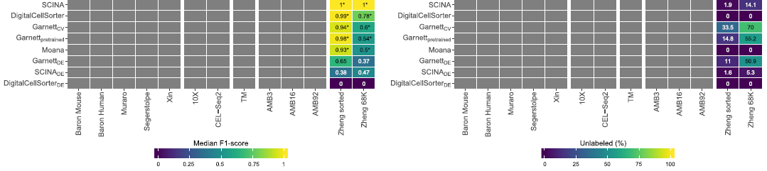
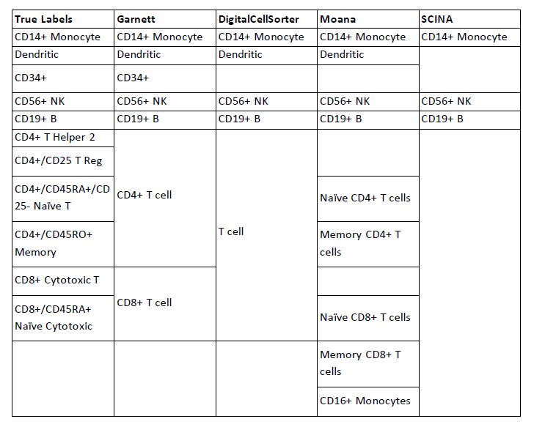
Pre-trained classifiers on PBMC

Slide 16
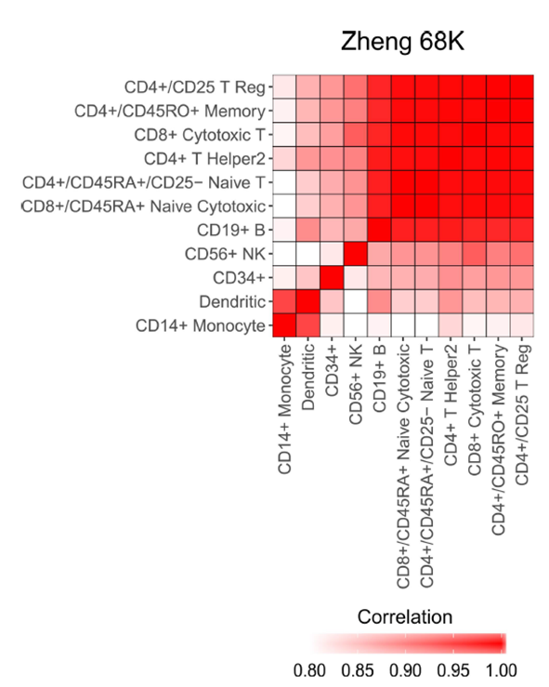
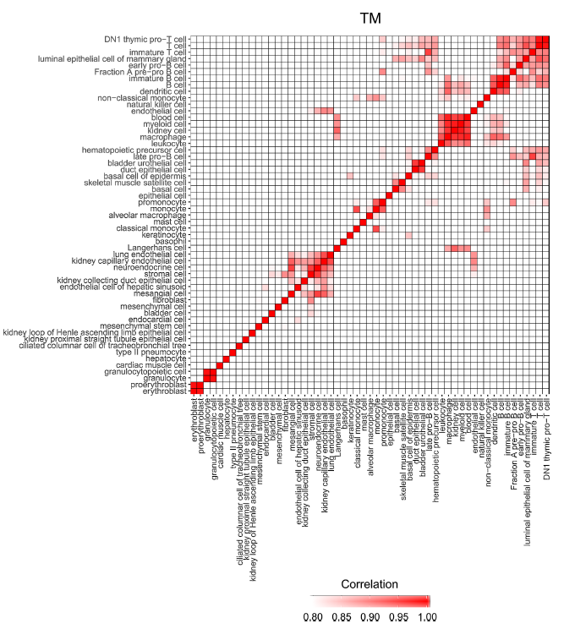
Classification performance depends on dataset complexity
Although TM and AMB92 have more cell populations (55 and 92, respectively) compared to Zheng 68K (11 populations), these populations are less correlated to one another, making the task easier for all the classifiers
Cells in the Zheng 68K dataset were annotated based on the correlation with cells in the Zheng sorted dataset

Slide 17
Performance evaluation across datasets
Classification performance across different protocols
PBMC datasets
pbmc1: 10X V2; 10X V3; CEL-Seq2; Drop-seq; InDrop; Smart-seq2; Seq-Well
pbmc2: 10X V2; CEL-Seq2; Drop-seq; InDrop; Smart-seq2; Seq-Well
Classification performance across different species
3 brain datasets: VISp and ATM (mouse); MTG (human)
Major lineage annotation with 3 cell populations
Deeper level of annotation with 34 cell populations
Classification performance across different protocols and different labs
4 human pancreatic datasets: Baron Human (InDrop), Muraro (CEL-Seq2), Segerstople (SMART-Seq2), and Xin (SMARTer)
Training on three datasets and test on one dataset
Original data
Aligned data using the mutual nearest neighbor (MNN) method
Notes:
VISp and ATM (mouse); MTG (human, single nucleus)
SMART-Seq v4

Slide 18
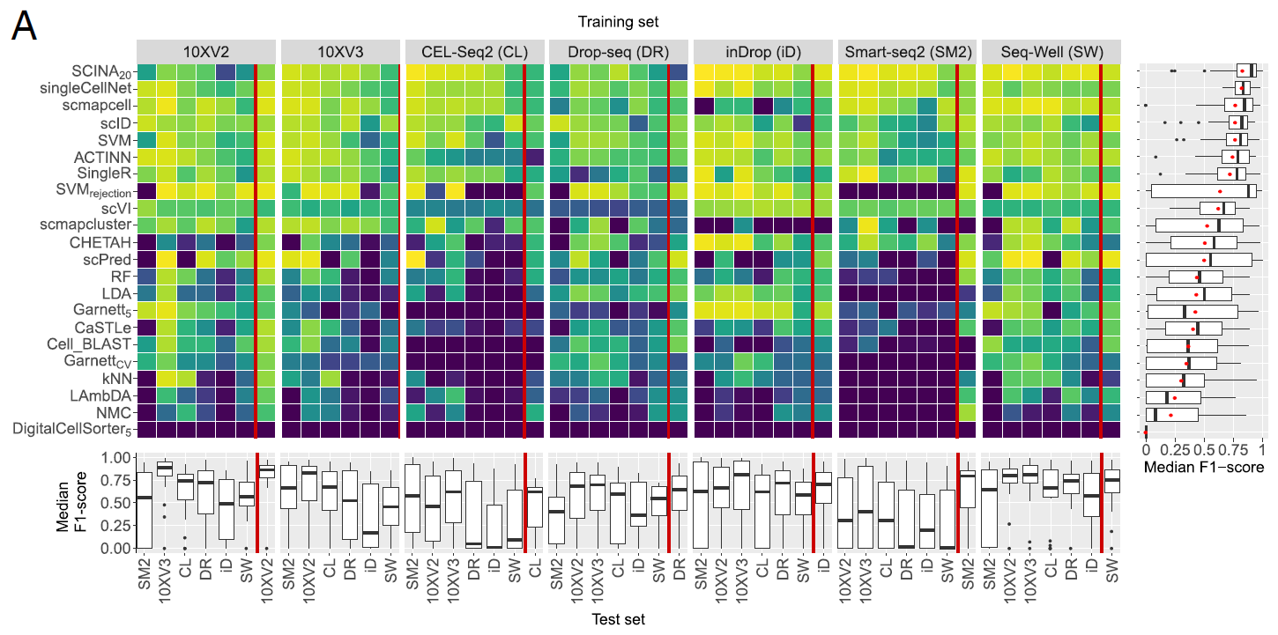

Classification performance across different protocols
Notes:
cellBench
pbmcBench
the comparison between different samples using the same protocol, with pbmc 1 used for training and pbmc2 used for testing

Slide 19
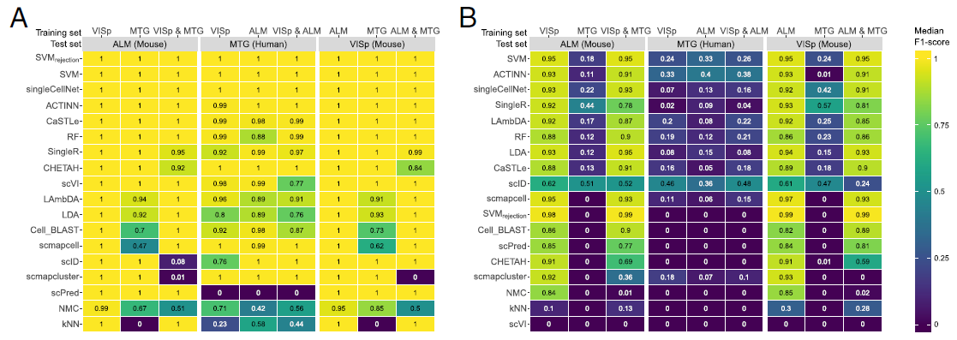
Classification performance across different species
AMB3
AMB34
For AMB3 with three major cell populations, all the classifiers performed almost perfectly when both the training and testing datasets were from the same species
Predicting the 34 cell populations in AMB34 dataset was more challenging, but almost all the classifiers also performed well within species
Train the model using a reference dataset from a species to predict cells from a different species didn’t work well, especially for deeply annotated datasets

Slide 20
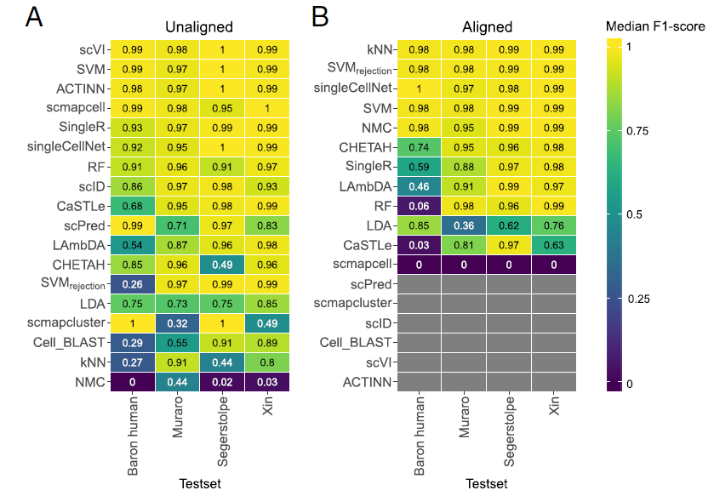
Classification performance across different protocols and different labs
Most classifiers performed good even the training and test datasets were from different labs using different protocols. Could also be because the pancreatic datasets were easier for classification
Some classifiers benefit from aligning datasets such as SVM_{rejection}, kNN, NMC, and singleCellNet
Some other classifiers failed to run over the aligned datasets (these classifiers work only with positive gene expression data, while the aligned datasets contain negative gene expression values)
Notes:
, such as ACTINN, scVI, Cell-BLAST, scID, scmapcluster, and scPred. These classifiers work only with positive gene expression data, while the aligned datasets contain positive and negative gene expression values

Slide 21
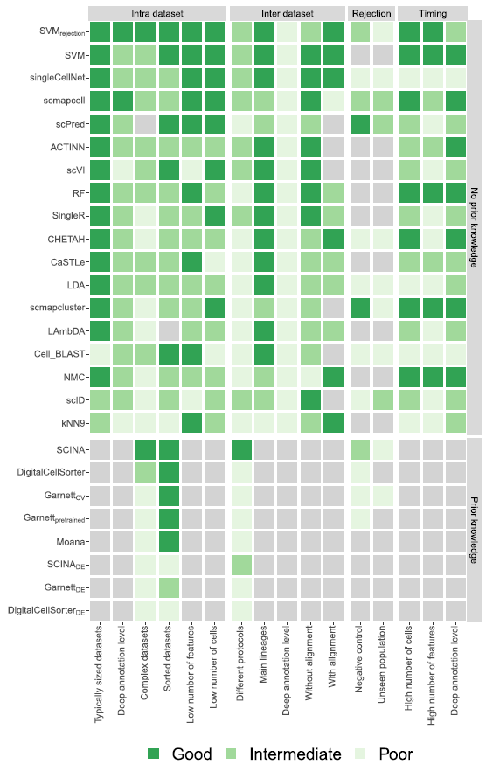
Summary
SVM/SVM_{rejection} classifiers have overall the best performance across the different experiments (need good training sets)
The performance of SingleR, Cell BLAST, and Garnett could be improved by using the built-in references or by providing a better definition of marker genes
It’s challenging for the annotation of complex datasets with overlapping classes or deep annotations, such as PBMC. SVM trained with a comprehensive training set, Cell BLAST, or Garnett with a better definition of marker genes would worth a try to solve the problem
Although scVI didn’t work well in deeply annotated datasets, but performed pretty good in the Zheng sorted PBMC dataset, could be a candidate for immune cell annotation

Slide 23
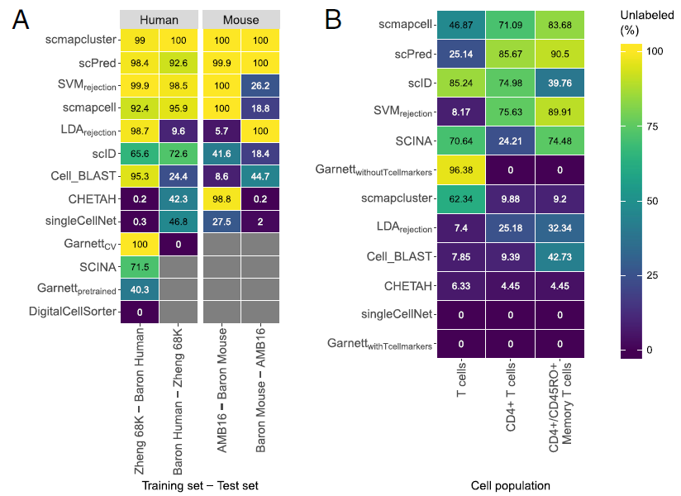
Rejection option evaluation

Slide 24
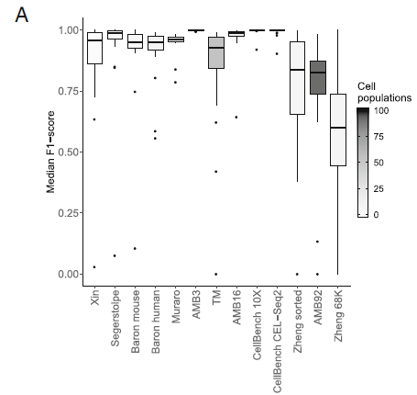
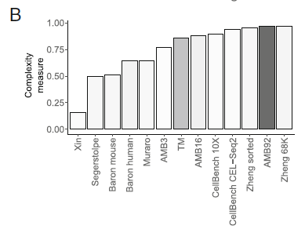
Classification performance depends on dataset complexity
Complexity: pairwise similarity between cell populations
When the complexity and/or the number of cell populations of the dataset increases, the performance generally decreases
Notes:
When the complexity and/or the number of cell populations of the dataset increases, the performance generally decreases
While both TM and AMB92 have more cell populations (55 and 92, respectively) compared to Zheng 68K (11 populations), these populations are less correlated to one another, making the task easier for all the classifiers

Slide 25
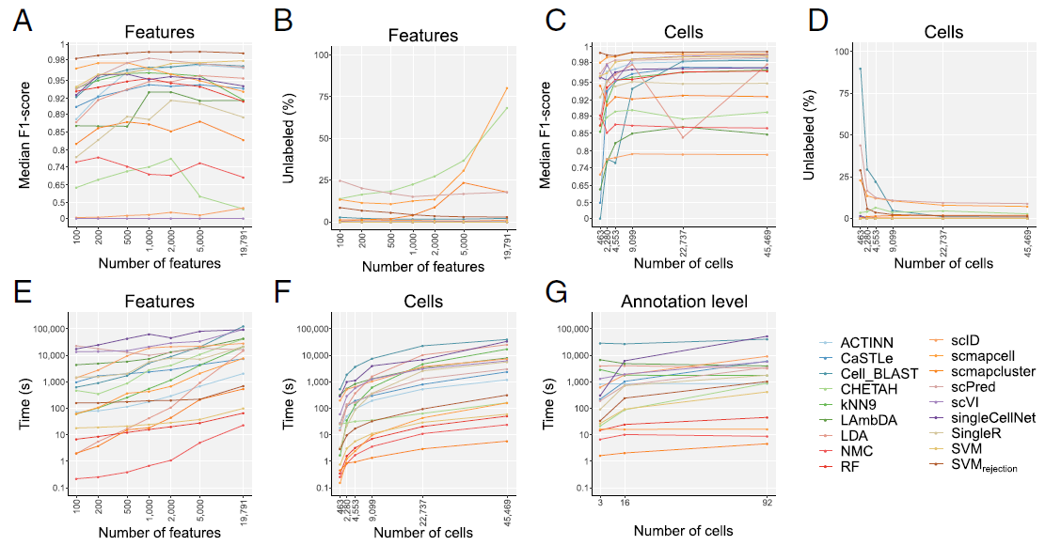

Slide 26
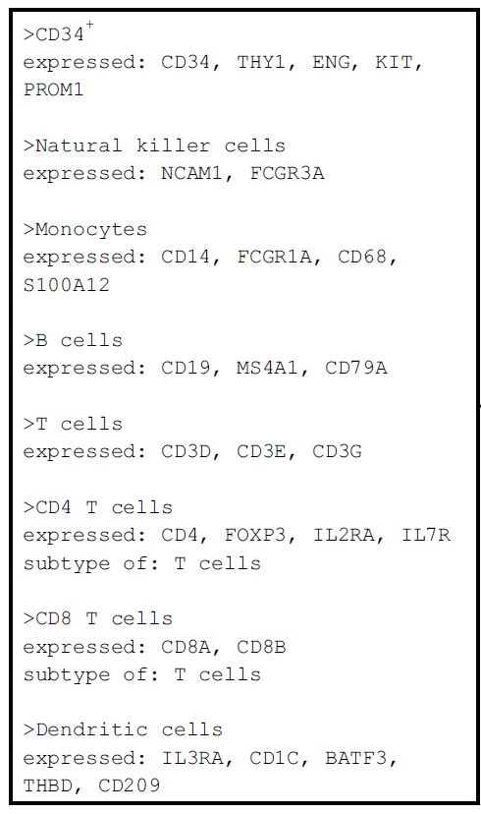

Slide 27
